Slide 1







Weighted Graphs
Every edge is labeled a numerical weight.
3
$$a$$
$$d$$
3
4
6
5
$$s$$
1
$$c$$
1
2
$$f$$
2
5
3
$$b$$
$$e$$
2
Assumption: No edge has negative weight.

Slide 2

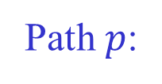





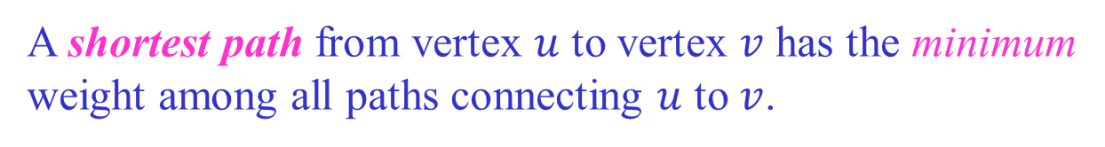
Length of a Path
The weight (length) of a path is the sum of the weights of its edges.
7 2 1 5
Path $p$:
$$a$$
$$b$$
$$c$$
$$d$$
$$e$$
Edge weights: $w(a, b)=7, w(b, c)=2, w(c, d)=1, w(d, e)=5$
Path weight $w(p) = 7+2+1+5 = 15$
A shortest path from vertex $u$ to vertex $v$ has the minimum
weight among all paths connecting $u$ to $v$.

Slide 3



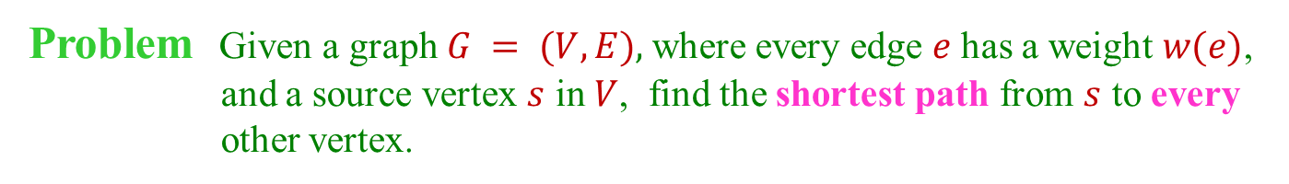


Single-Source Shortest Paths
Problem Given a graph $G = (V, E),$where every edge $e$ has a weight $w(e)$,
and a source vertex $s$ in $V$, find the shortest path from $s$ to every
other vertex.
3
$$a$$
$$d$$
3
4
6
source
5
$$s$$
1
$$c$$
1
2
$$f$$
2
5
3
$$b$$
$$e$$
2
$$s a b c d e f$$
weight $0 3 4 6 6 6 9$
path $s$ $s$-$a$ $s$-$a$-$b$ $s$-$a$-$b$-$c$ $s$-$a$-$d$ $s$-$a$-$b$-$e$ $s$-$a$-$b$-$e$-$f$

Slide 4
Applications
Transportation (shortest route from Ames to Phoenix?)
Network routing (how to direct packets to a destination across a network?)
Telecommunications
Speech interpretation (best interpretation of a spoken sentence)
Robot path planning
Medical imaging
Building block for network algorithms
...

Slide 5

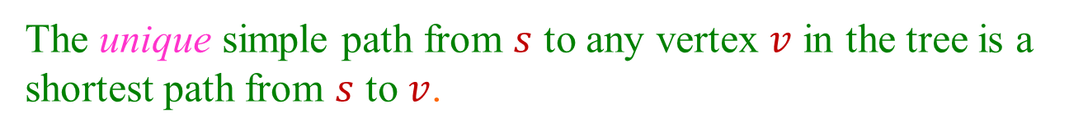
Shortest-Path Tree
The unique simple path from $s$ to any vertex $v$ in the tree is a
shortest path from $s$ to $v$.
3
$$a$$
$$d$$
3
$$s$$
1
$$c$$
$$f$$
2
$$e$$
3
$$b$$
2
The vertices in the tree are exactly those reachable from $s$ in $G$.
Similar to the breadth-first tree (where all edges have weight 1).

Slide 6
Negative Cycle & Unreachable Vertices
The graph is assumed not to have a negative cycle.
It may have unreachable vertices.
a
b
4
3
7
3
4
h
i
s
6
d
g
2
c
∞
∞
5
11
8
source
0
5
5
3
-8
3
2
e
3
f
∞
2
5
7
j
-6
unreachable from s
negative cycle

Slide 7





No Cycle in a Shortest Path
A shortest path cannot contain a non-negative cycle either
because otherwise the removal of such a cycle would
reduce the path weight.
$$w$$
$$u$$
$$v$$
$$y$$
$$x$$
Any zero-weight cycle in a shortest path can be removed.
So we only need to consider shortest path of $≤ |V| – 1$edges.

Slide 8

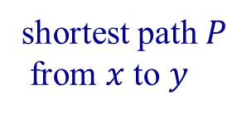




Subpath Must Be Shortest
Any subpath of a shortest path is the shortest of all paths between
the two intermediate vertices.
x
Below is the reasoning:

Slide 9
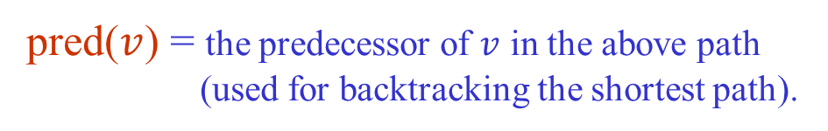
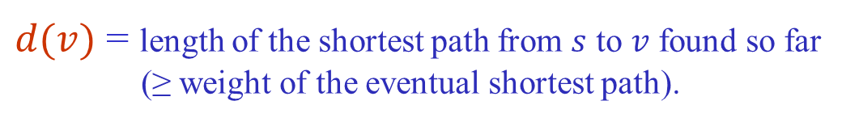
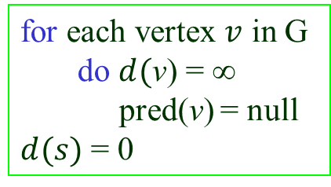
Representing Shortest Paths
During the execution of a shortest-path algorithm, maintain
two maps:
$d(v)$ = length of the shortest path from $s$ to $v$ found so far
(≥ weight of the eventual shortest path).
pred($v$) = the predecessor of $v$ in the above path
(used for backtracking the shortest path).
Initialization
for each vertex $v$ in G
do $d($v) = ∞
pred(v) = null
$d(s)$ = 0

Slide 10



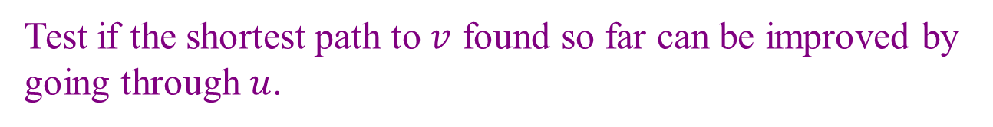


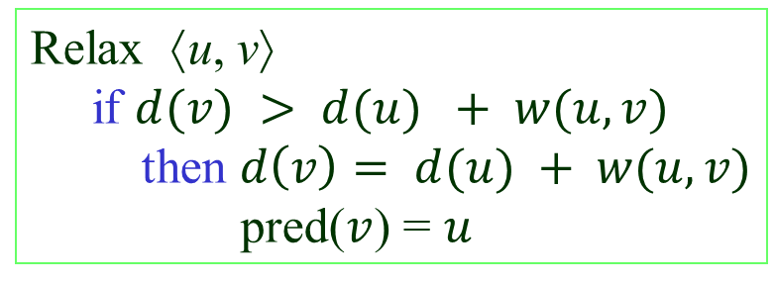


Edge Relaxation
Test if the shortest path to $v$ found so far can be improved by
going through $u$.
$$u$$
$$s$$
$$v$$
w
pred(v)
Relax ⟨u, v⟩
if $d(v) > d(u) + w(u, v)$
then $d\left(v\right)= d(u) + w(u, v)$
pred($v$) = $u$
$$d(v) > d(u) + w(u, v)$$
u
pred(v)
Shortest path algorithms differ in
the number of times the edges are
relaxed and the order in which they
are relaxed.
$$s$$
$$v$$
$$w$$

Slide 11
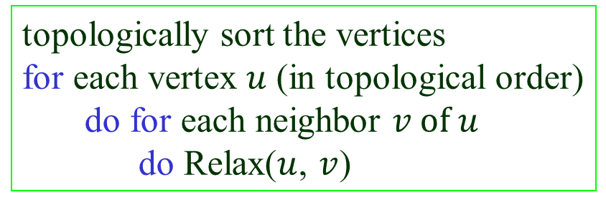

Shortests Paths in DAGs
When the graph is a directed acyclic graph (DAG), relax
edges according to a topological ordering of vertices.

Slide 12
An Example
9
5
r
∞
∞
y
3
6
2
∞
∞
3
4
x
z
s
0
9
1
∞
t
Topological order: s, r, y, x, z, t

Slide 13
9
5
r
∞
2
y
3
6
2
3
∞
3
4
x
z
s
0
9
1
9
t
Topological order: s, r, y, x, z, t
Relax edges ⟨s, r⟩, ⟨s, x⟩, ⟨s, t⟩.

Slide 14
9
5
r
7
2
y
3
6
2
3
11
3
4
x
z
s
0
9
1
9
t
Topological order: s, r, y, x, z, t
Relax edges ⟨r, x⟩, ⟨r, y⟩, ⟨r, z⟩.

Slide 15
9
5
r
7
2
y
3
6
2
3
10
3
4
x
z
s
0
9
1
9
t
Topological order: s, r, y, x, z, t
Relax edge ⟨y, z⟩.

Slide 16
9
5
r
7
2
y
3
6
2
3
7
3
4
x
z
s
0
9
1
9
t
Topological order: s, r, y, x, z, t
Relax edge ⟨x, z⟩.

Slide 17
Finish
9
5
r
7
2
y
3
6
2
3
7
3
4
x
z
s
0
9
1
8
t
Topological order: s, r, y, x, z, t
Relax edge ⟨z, t⟩.

Slide 18



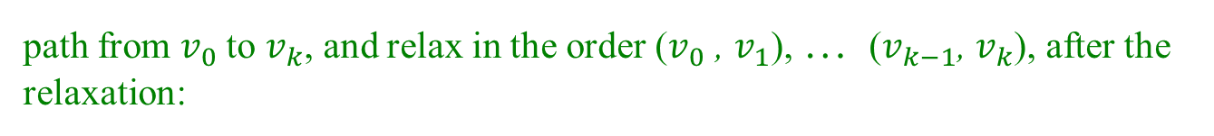

Correctness
Path relaxation property: If is a shortest
$$v_{0}$$
$$v_{1}$$
$$v_{k}$$
path from $v_{0}$to $v_{k}$, and relax in the order ($v_{0}$ , $v_{1}$), … ($v_{k−1}$, $v_{k}$), after the
relaxation:
$d(v_{k})$ stores the shortest path length
pred$(v_{k})$ stores the predecessor on the shortest path.
The topological order guarantees that edges on every path from the
source will be relaxed in the order in which they appear on the path.
Thus, the path relaxation property is satisfied and the algorithm
works correctly.

Slide 19
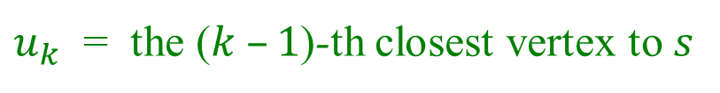
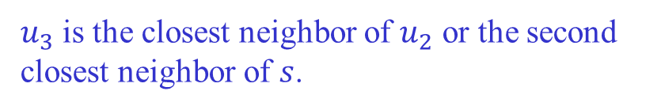



Dijkstra’s Algorithm
Applicable when all edge weights are non-negative.
Idea: Successively compute $u_{1}$, $u_{2}$, …, $u_{n}$, where
$u_{k}$ = the ($k –1$)-th closest vertex to $s$
Greedy strategy (same as breadth-first search if all weights are 1):
$$u_{1}= s$$
$u_{2}$is the closest neighbor of $s$; i.e.,
$w(s, u_{2}) = min⁡\{ w(s,v) |$⟨$s, v in E \}$
$u_{3}$ is the closest neighbor of $u_{2}$ or the second
closest neighbor of $s$.
...

Slide 20
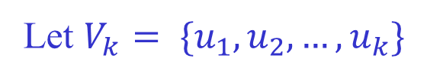




How to Find the Next Closest?
Let $V_{k}= \{u_{1},u_{2},…,u_{k}\}$
$u_{k+1}$ is the vertex with minimum $d$-value in $V\left(G\right)− V_{k}$.
Fact The shortest path to $u_{k+1}$ goes through only vertices in $V_{k}$.
Suppose there exists a vertex $x$ not in $V_{k}$but on the shortest path to $u_{k+1}$.
$$V_{k}$$
$u_{k+1}$
$$s$$
$$x$$
Then $x$ is closer to $s$ than $u_{k+1}. It should have been included in{ V}_{k}$.

Slide 21
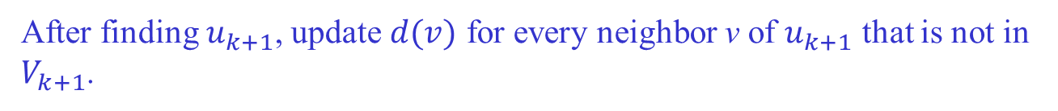


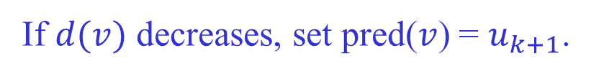


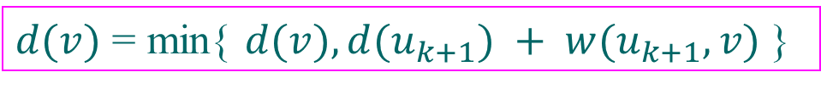

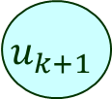
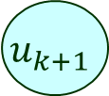


Relaxation
After finding $u_{k+1}$, update $d(v)$ for every neighbor v of $u_{k+1}$ that is not in $V_{k+1}$.
$$V_{k}$$
$$V_{k+1}$$
$$u_{k+1}$$
$$u_{k+1}$$
$$s$$
$$s$$
$$x$$
$$x$$
$$v$$
$$v$$
$d(v)$ = min{ $d(v), d(u_{k+1}) + w(u_{k+1}, v)$}
If $d(v)$ decreases, set pred($v$) = $u_{k+1}$.

Slide 22
An Example
∞
∞
a
7
d
2
5
2
∞
4
5
b
1
f
s
3
∞
0
1
7
4
e
c
4
∞
∞
$u_{k+1}$ is the vertex with minimum $d$-value in $V\left(G\right)− V_{k}$.

Slide 23

2
7
∞
a
d
2
5
2
5
4
5
b
1
f
s
3
∞
0
1
7
4
e
c
4
∞
4
$$V_{1}=\{s\}$$

Slide 24

2
9
a
7
d
2
5
2
4
4
5
b
1
f
s
3
∞
0
1
7
4
e
c
4
∞
4
$$V_{2}=\{s,a\}$$

Slide 25

2
8
a
7
d
2
5
2
4
4
5
b
1
f
s
3
∞
0
1
7
4
e
c
4
7
4
$$V_{3}=\{s,a, b\}$$

Slide 26

2
8
a
7
d
2
5
2
4
4
5
b
1
f
s
3
∞
0
1
7
4
e
c
4
7
4
$$V_{4}=\{s,a, b, c\}$$

Slide 27

2
8
a
7
d
2
5
2
4
4
5
b
1
f
s
3
14
0
1
7
4
e
c
4
7
4
$$V_{5}=\{s,a, b, c, e\}$$

Slide 28

2
8
a
7
d
2
5
2
4
4
5
b
1
f
s
3
13
0
1
7
4
e
c
4
7
4
$$V_{6}=\{s,a, b, c, e, d\}$$

Slide 29

2
8
a
7
d
2
5
2
4
4
5
b
1
f
s
3
13
0
1
7
4
e
c
4
7
4
$$V_{7}=\left\{s,a, b, c, e, d, f\right\}=V$$

Slide 30
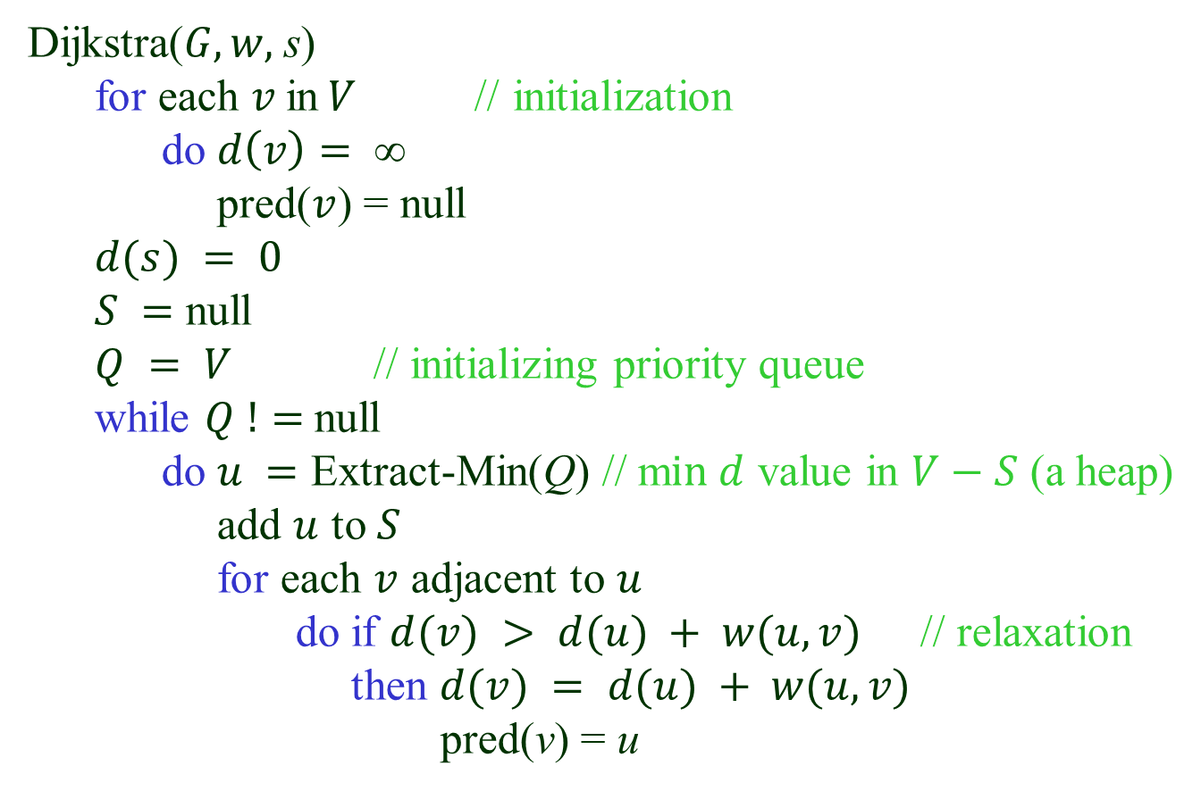
Algorithm Description
Dijkstra($G, w,$s)
for each $v$in$V$// initialization
do $d\left(v\right)= $
pred($v$) = null
$d(s) = 0$
$S =$ null
$Q = V$ // initializing priority queue
while $Q !=$null
do $u =$ Extract-Min(Q) // m$in d$ value in $V−S$ (a heap)
add $u$ to $S$
for each $v$ adjacent to $u$
do if $d(v) > d(u) + w(u, v)$// relaxation
then $d(v) = d(u) + w(u, v)$
pred(v) = u

Slide 31
Analysis
$Q$ build-queue extract-min decrease-key total
#operations 1 |V | |E|
Array $O(|V|) O(|V|) O(1) O({|V|}^{2})$
Heap $O(|V|) O(log⁡|V|) O(\log\left|V\right|) O(|E|\log{|V|})$

